Slide 1

“Microsoft Studios”:
How should Microsoft enter the movie business?
G. Haws & K. Hayes

Slide 2
In order to maximize its investment, what scale of films should Microsoft produce?
What types of studios should Microsoft emulate?
Which directors should Microsoft seek out?
Sources:
TheMovieDB.org
Box Office Mojo
IMBD

Slide 3
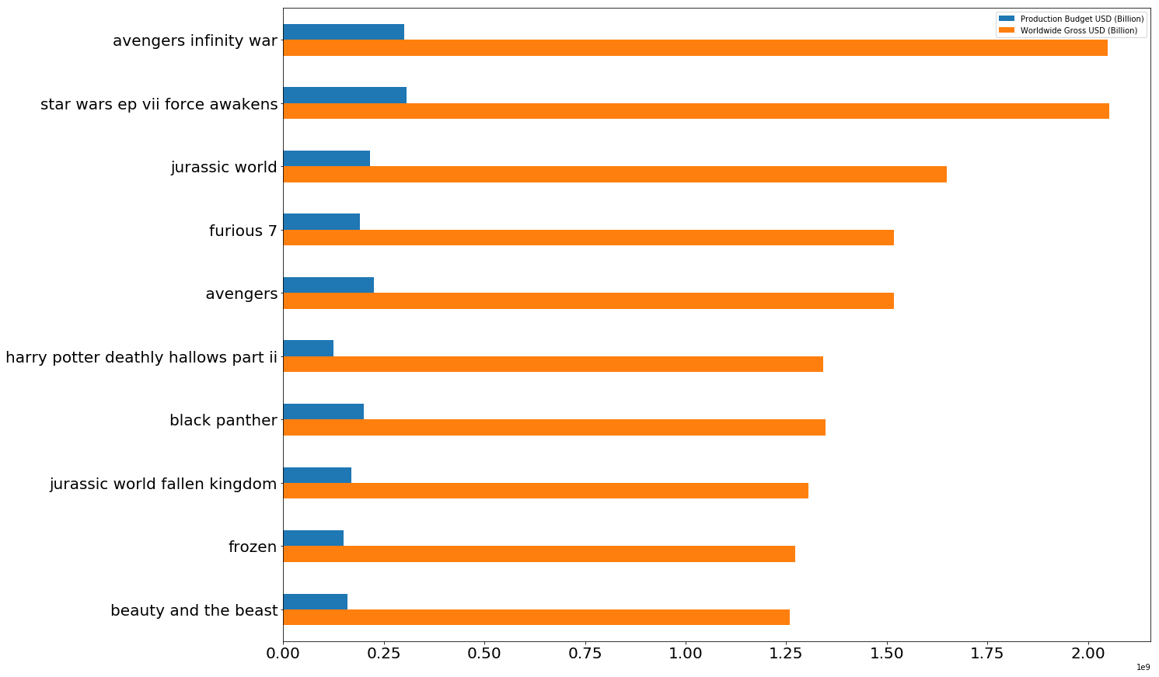
Top Net grossing movies (2010-Now)

Slide 4
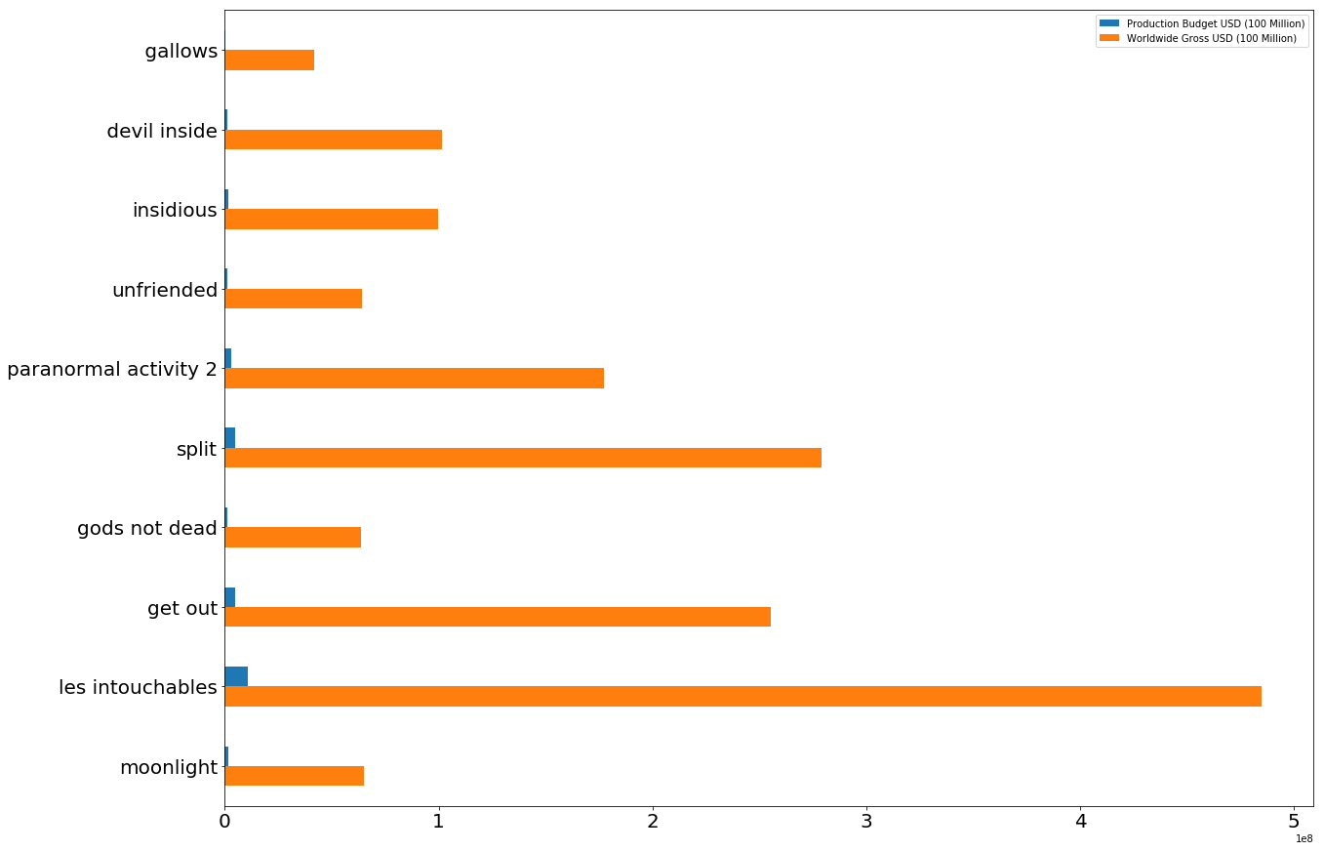
Movies with Top ROI (2010-Now)

Slide 5
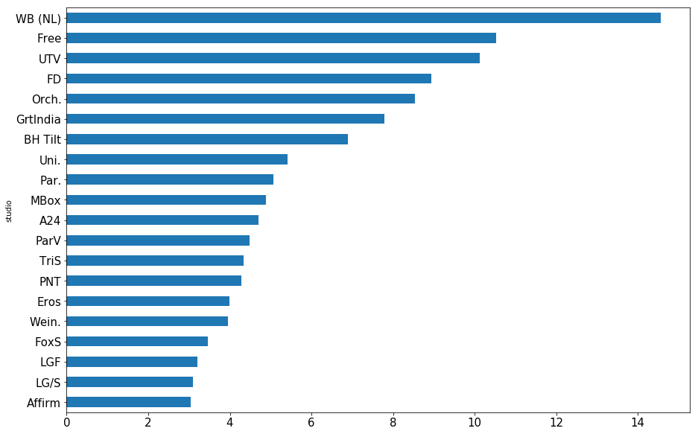
Studios with Highest Mean ROI (2010-Now)

Slide 6
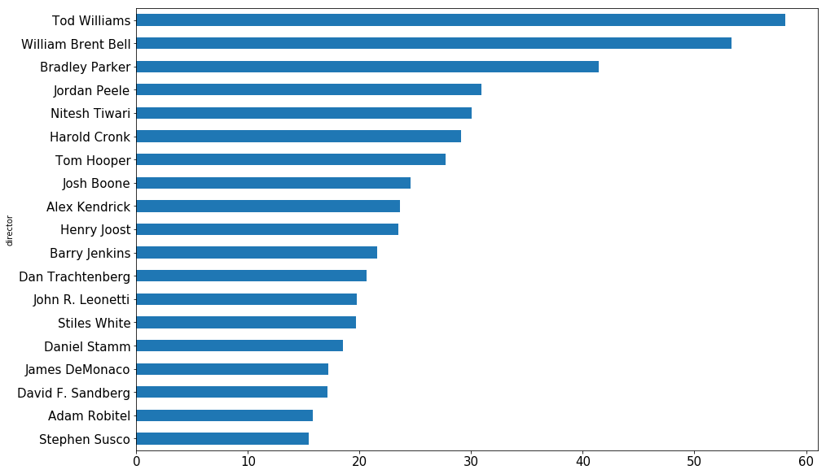
Directors with Highest Mean ROI (2010-Now)
Outlier: Travis Cluff : 415.56

Slide 7
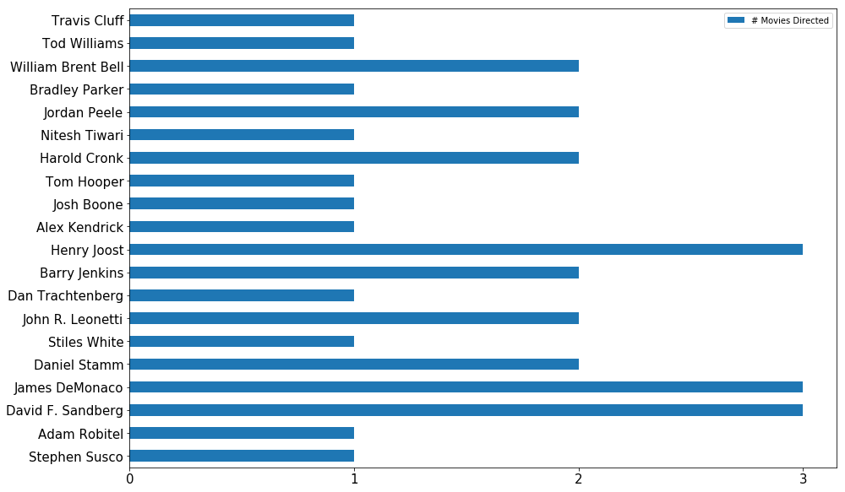
Size of director filmography

Slide 8
Recommendations
Instead of focusing on overall returns, focus on ROI.
Model operations on studios capable of producing films that maximize ROI.
Hire directors that can creating engaging films, despite heavy budgetary constraints.
Hire new directors.

Slide 9
Next Steps:
Research how the listed studios and directors are able to produce profitable, low-budget movies.
Research the roll of home distribution in low-budget films.

